Slide 1


Lecture1 Review
DATA STRUCTURE
AND ALGORITHMS
(CS 201)
1
Fall (2025-2026)

Slide 2

Course description
THIS COURSE PRESENTS :
Arrays, Linear lists, Queues, and Stacks, Tree structures and traversals, Dictionaries and Search trees, Heaps, Tries, Sorting and Searching, Hashing, Basic graph algorithms: Traversals, Minimum Spanning Trees, Shortest Paths.

Slide 3
Course Learning Objectives
Use arrays and linked lists to implement and apply linear lists and the related operations (insertion, deletion and traversal).
Implement and use special linear lists (stacks and queues) and the related basic operations (push and pop; Enqueue and Dequeue).
Implement and use simple sorting algorithms.
Apply searching algorithms including sequential search, binary search and hashing techniques.
Implement and use the non-linear list tree data structures (Binary trees, Binary Search Trees) and the related operations (insert, delete and traverse).
Use the graph data structure and apply common graph algorithms.
Develop teamwork discipline through working in teams.

Slide 4
Course Learning Objectives
Implement and manipulate linear data structures such as arrays and linked lists, performing fundamental operations including insertion, deletion, and traversal.
Apply and implement special linear data structures such as stacks and queues, utilizing their core operations (push, pop, enqueue, and dequeue).
Design and implement basic sorting algorithms to organize data efficiently.
Apply searching algorithms, including sequential search, binary search, and hashing techniques.
Implement and manipulate non-linear data structures, particularly binary trees and binary search trees, performing key operations such as insertion, deletion, and traversal.
Utilize graph data structures and apply fundamental graph algorithms for problem-solving.
Demonstrate effective teamwork skills by collaborating within groups to develop algorithmic solutions.

Slide 5

Assessment Strategy
Grading:
Course work (Quizzes - Activates ) | 10 %
Practical(Course Project - Labs) | 20 %
Midterm Exam | 20 %
Final Exam | 50 %
Midterm Exam | Date : 8-11-2025 to 13-11-2025

Slide 6
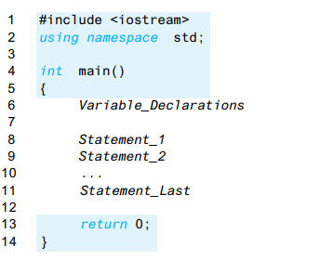

C++ Program Layout
The Typical C++ Layout

Slide 7
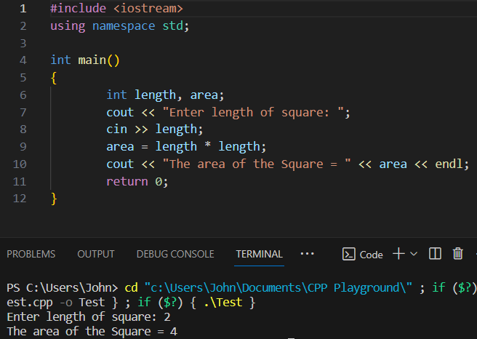
C++ Program Layout
Compiler directive to add
Library for Input/output
The program calculates the area of a square.
- Input: Length
- Output: Area
Steps:
Ask for the length as input
Calculate the area (A = L^2)
Print the output
End Program
Names defined in iostream are in standard namespace
Variables Declaration
Statements
Notes:
High-level languages resemble human languages in many ways. They are designed to be easy for human beings to write programs in and to be easy for human beings to read
It might seem silly for simple program but it is crucial for complex ones
The reason that C++ has namespaces at all is because there are so many things to name
C++ divides names into namespaces. A namespace is a collection of
names, such as the names cin and cout. A statement that specifies a namespace
in the way illustrated by the following is called a using directive:
using namespace std;

Slide 8
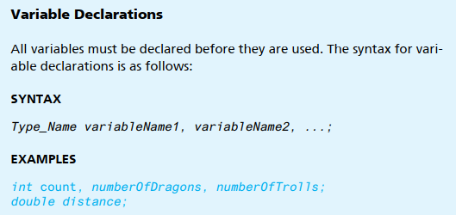
Variables
Variables are placeholders of data
Every variable in a C++ program should be declared before usage
The declaration consists of type name and variable name and ends with a semicolon

Slide 9
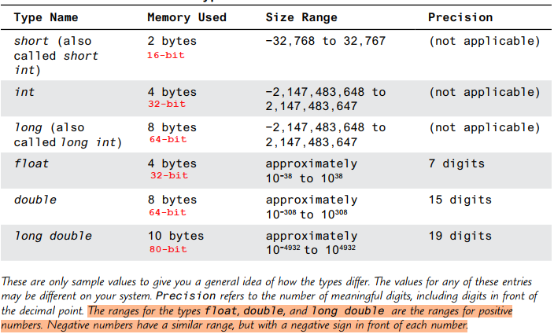
Data Types for Numbers
9.22 e18
9.22 e18
Notes:
Number systems, binary rep in memory
Sign bit, ranges
Talk about int and double
Casting
. If both operands (that is, both numbers) are of type int, then the result of combining them with an arithmetic operator is of type int. If one, or both, of the operands is of type double,
then the result is of type double.

Slide 10
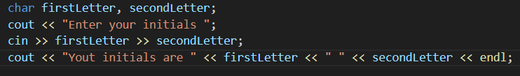

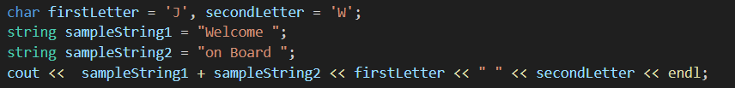
Data Types for Letters
char : short for character and holds only one letter/character
string: holds a string of characters like words and sentences
  You must add string library
Notes:
String dynamic
Char byte

Slide 11
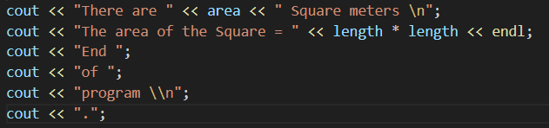

Input and Output
Print result using cout <<
User Inputs using cin >>
<< is called insertion operator

Slide 12
Write a program to compute the Area of a Circle.

Slide 13
Trace a Program Execution
#include <iostream>
using namespace std;
int main()
{
double radius;
const double PI = 3.14159;
// Step 1: Read in radius
radius = 20;
// Step 2: Compute area
double area = radius * radius * PI;
// Step 3: Display the area
cout << "The area is ";
cout << area << endl;
}
#include <iostream>
using namespace std;
int main()
{
double radius;
const double PI = 3.14159;
// Step 1: Read in radius
radius = 20;
// Step 2: Compute area
double area = radius * radius * PI;
// Step 3: Display the area
cout << "The area is ";
cout << area << endl;
}
#include <iostream>
using namespace std;
int main()d
{
double radius;
const double PI = 3.14159;
// Step 1: Read in radius
radius = 20;
// Step 2: Compute area
double area = radius * radius * PI;
// Step 3: Display the area
cout << "The area is ";
cout << area << endl;
}
#include <iostream>
using namespace std;
int main()
{
double radius;
const double PI = 3.14159;
// Step 1: Read in radius
radius = 20;
// Step 2: Compute area
double area = radius * radius * PI;
// Step 3: Display the area
cout << "The area is ";
cout << area << endl;
}
No semicolon

Slide 14
Trace a Program Execution
#include <iostream>
using namespace std;
int main()
{
double radius;
const double PI = 3.14159;
// Step 1: Read in radius
radius = 20;
// Step 2: Compute area
double area = radius * radius * PI;
// Step 3: Display the area
cout << "The area is ";
cout << area << endl;
}
allocate memory for radius
radius
no value
// Declaring a variable of type double

Slide 15
Trace a Program Execution
allocate memory for PI
memory
#include <iostream>
using namespace std;
int main()
{
double radius;
const double PI = 3.14159;
// Step 1: Read in radius
radius = 20;
// Step 2: Compute area
double area = radius * radius * PI;
// Step 3: Display the area
cout << "The area is ";
cout << area << endl;
}
radius
no value
Literal
PI
3.14159
// Naming a constant, should have a value.

Slide 16
Trace a Program Execution
assign 20 to radius
memory
#include <iostream>
using namespace std;
int main()
{
double radius;
const double PI = 3.14159;
// Step 1: Read in radius
radius = 20;
// Step 2: Compute area
double area = radius * radius * PI;
// Step 3: Display the area
cout << "The area is ";
cout << area << endl;
}
radius
20
PI
3.14159
// Assignment Statements
Literal

Slide 17
Trace a Program Execution
#include <iostream>
using namespace std;
int main()
{
double radius;
const double PI = 3.14159;
// Step 1: Read in radius
radius = 20;
// Step 2: Compute area
double area = radius * radius * PI;
// Step 3: Display the area
cout << "The area is ";
cout << area << endl;
}
memory
radius
20
PI
3.14159
area
1256.636
compute area and assign it to a new variable area
// Declare variable & assign it

Slide 18
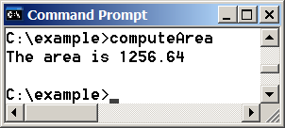
Trace a Program Execution
#include <iostream>
using namespace std;
int main()
{
double radius;
const double PI = 3.14159;
// Step 1: Read in radius
radius = 20;
// Step 2: Compute area
double area = radius * radius * PI;
// Step 3: Display the area
cout << "The area is ";
cout << area << endl;
}
memory
radius
20
PI
3.14159
area
1256.636
print a message to the console

Slide 19
Reading Input from the Keyboard
#include <iostream>
using namespace std;
int main()
{
double radius;
const double PI = 3.14159;
// Step 1: Read in radius
cout << "Enter a radius: ";
cin >> radius;
// Step 2: Compute area
double area = radius * radius * PI;
// Step 3: Display the area
cout << "The area is ";
cout << area << endl;
}
// Use the cin object to read
// input from the keyboard.

Slide 20
Numeric Operators
+, -, *, /, and %
5 / 2 yields an integer 2.
5.0 / 2 yields a double value 2.5
5 % 2 yields 1 (the remainder of the division)

Slide 21
Increment and Decrement Operators
Operator | Name | Description
var++ | post-increment | The expression (var++) evaluates to the original value in var and increments var by 1.
++var | pre-increment | The expression (++var) increments var by 1 and evaluates to the new value in var after the increment.
var-- | post-decrement | The expression (var--) evaluates to the original value in var and decrements var by 1.
--var | pre-decrement | The expression (--var) decrements var by 1 and evaluates to the new value in var after the decrement.

Slide 22
if Statements
Boolean Expression
if ( radius >= 0 )
{
area = radius * radius * PI;
cout << "The area for the circle of " << " radius "
<< radius << " is " << area;
}
Outer parentheses: Required
Outer parentheses: Required
( radius >= 0 )
NO Semicolon!!
{
}
Braces can be omitted if the block contains only one statement

Slide 23
Relational Operators

Slide 24
Example
Write a program that prompts the user to enter an integer. If the number is a multiple of 5, display HiFive. Otherwise, if the number is even, display HiEven.
#include <iostream>
using namespace std;
int main()
{
// Prompt the user to enter an integer
int number;
cout << "Enter an integer: ";
cin >> number;
if (number % 5 == 0)
{
cout << "HiFive" << endl;
}
else
{
if (number % 2 == 0 )
cout << "HiEven" << endl;
}
return 0;
}
Nested

Slide 25
Multiple Alternative if Statements
Only if the body of else is just an if-statement
if (score >= 95.0)
cout << "Grade is A";
else
if (score >= 80.0)
cout << "Grade is B";
else
if (score >= 65.0)
cout << "Grade is C";
else
cout << "Grade is F";
if (score >= 95.0)
cout << "Grade is A";
else if (score >= 80.0)
cout << "Grade is B";
else if (score >= 65.0)
cout << "Grade is C";
else
cout << "Grade is F";

Slide 26
Logical Operators

Slide 27
switch Statements
switch (selected_Option)
{
case 0:
  //create new file;
  break;
case 1:
  //open existing file;
  break;
case 2:
  //close current file;
  break;
case 3:
  //exit program;
  break;
default:
  cout << "Error: invalid input" << endl;
}

Slide 28
switch Statements
Must
switch (selected_Option)
{
case 0:
  //create new file;
  break;
case 1:
  //open existing file;
  break;
case 2:
  //close current file;
  break;
case 3:
  //exit program;
  break;
default:
  cout << "Error: invalid input" << endl;
}
Must yield a value of char, int, or enum type (can be expression)
Must be a const of the same type as switch-expression

Slide 29
switch Statements
switch (selected_Option)
{
case 0:
  //create new file;
  break;
case 1:
  //open existing file;
  break;
case 2:
  //close current file;
  break;
case 3:
  //exit program;
  break;
default:
  cout << "Error: invalid input" << endl;
}
Can be removed, but then next case will be executed
Optional, to perform actions when no case is matched.

Slide 30
Loops

Slide 31
For Statment
for (initialization; condition; inc or dec)
The initial-action in a for loop can be a list of zero or more comma-separated expressions.
The action-after-each-iteration in a for loop can be a list of zero or more comma-separated statements.
You can have NO stopping condition (infinite loop)
for (int i = 1; i < 100; cout << (i++));
for (i = 0; i < 100; i++)
for (i = 0; i < 100; i++)
for (i = 0; ; i++)
for (int i = 1; i < 100; i++) {
cout << i;}

Slide 32
Nested Loops
What does this program do?
for (int i = 1; i <= 9; i++)
{
for (int j = 1; j <= 9; j++)
{
// Display the product and align properly
cout << " " << i * j;
}
cout << "\n";
}
1 2 3 4 5 6 7 8 9
2 4 6 8 10 12 14 16 18
3 6 9 12 15 18 21 24 27
4 8 12 16 20 24 28 32 36
5 10 15 20 25 30 35 40 45
6 12 18 24 30 36 42 48 54
7 14 21 28 35 42 49 56 63
8 16 24 32 40 48 56 64 72
9 18 27 36 45 54 63 72 81

Slide 33
Nested Loops
1 2 3 4 5 6 7 8 9
2 4 6 8 10 12 14 16 18
3 6 9 12 15 18 21 24 27
4 8 12 16 20 24 28 32 36
5 10 15 20 25 30 35 40 45
6 12 18 24 30 36 42 48 54
7 14 21 28 35 42 49 56 63
8 16 24 32 40 48 56 64 72
9 18 27 36 45 54 63 72 81
What is the chang in the program to print the figure shown?

Slide 34
while Loops
int count = 0;
while (count < 100)
{
  cout << "Welcome to C++!\n";
  count++;
}
// loop continuation condition
// loop body

Slide 35
Example: Write a program that reads and calculates the sum of an unspecified number of integers. The input 0 signifies the end of the input.
#include <iostream>
using namespace std;
int main()
{
int data;
cout << "Enter an integer (the input ends if it is 0): ";
cin >> data;
// Keep reading data until the input is 0
int sum = 0;
while (data != 0)
{
sum += data;
// Read the next data
cout << "Enter an integer (the input ends if it is 0): ";
cin >> data;
}
cout << "The sum is " << sum << endl;
return 0;
}

Slide 36
do-while Loop
do
{
// Loop body;
Statement(s);
} while (loop-continuation-condition);

Slide 37
#include <iostream>
using namespace std;
int main()
{
// Keep reading data until the input is 0
int sum = 0;
int data = 0;
do
{
sum += data;
// Read the next data
cout << "Enter an integer (the input ends if it is 0): ";
cin >> data;
}
while (data != 0);
cout << "The sum is " << sum << endl;
return 0;
}

Slide 38
Example: Using for Loops
What does this program do?
// Initialize sum
double sum = 0;
// Add 0.01, 0.02, ..., 0.99, 1 to sum
for (double i = 0.01; i <= 1.0; i = i + 0.01)
sum += i;
// Display result
cout << "The sum is " << sum << endl;
// Initialize sum
double sum = 0;
// Add 0.01, 0.02, ..., 0.99, 1 to sum
for (double i = 0.01; i <= 1.0; i = i + 0.01)
sum += i;
// Display result
cout << "The sum is " << sum << endl;

Slide 39
Arrays

Slide 40
Introducing Arrays
Array is a data structure that represents a collection of the same types of data.

Slide 41
Declaring Array Variables
datatype arrayRefVar[arraySize];
Example:
double myList[10]; // the indices are from 0 to 9
C++ requires that the array size used to declare an array must be a constant expression.
int size = 4;
double myList[size]; // Wrong
const int size = 4;
double myList[size]; // Correct
✔

Slide 42
Using Indexed Variables
After an array is created, use indexed variables as a regular variable:
double myList[4];
  myList[0] = 5;
  myList[1] = 9;
  myList[2] = myList[0] + myList[1];

Slide 43
Using Indexed Variables
C++ does not check array’s boundary
When an array is created, its elements are assigned with arbitrary values.
double myList[10];
cout << myList[2] << endl;
cout << myList[12] << endl;
!
!

Slide 44
Printing arrays
cout << myList; // Not what you want/mean;
To print a regular array, print each element using a loop:
for (int i = 0; i < ARRAY_SIZE; i++)
cout << myList[i] << " ";

Slide 45



